Slide 1
File System File System Management and Optimization Example File Systems

Slide 2
Review
File System
Manages the information stored and hides the complexity on the storage devices
Provides the users access information in a convenient way and a uniform logical view
Is stored on disks
Implementations
File: Contiguous, Linked List, Linked List using a Table in Memory (FAT), i-nodes (same as multi-level paging)
Directory: Fixed size entries, one per file containing file name & attributes
File Name: fixed size, part of block, stored in heap
Utilities:
LFS (write data to end the log and using cleaner thread)
JFS (store log file and using atomic transaction)
VFS (uniform logical view for file system)

Slide 3
Review
File
Abstraction, Object and Mechanism
Name, Path (absolute vs. relative), Structure, Type, Access, Attributes, Operations
Directory (Single level vs. Hierarchy)
Sharing
Traditional /hard linking (using one i-node)
Symbolic linking (using larger than one i-node that references to path of file)

Slide 4
Objectives…
File System Management & Optimization
Disk Space Management
File System Backups
File System Consistency
File System Performance
Defragmenting Disks
Example File Systems
CD-ROM File Systems
The MS-DOS File Systems
The UNIX V7 File Systems

Slide 5
File System Management & Optimization Disk Space Management
Block size
Files are stored in fixed-size blocks of bytes, not necessarily adjacent
How large the block should be?
Large
Is efficiently read, but waste of HDD space
Small
Is good use of HDD space
Span multiple blocks phải chia nhiều block
Many disk accesses to read a file (reduce performance – waste time)
A good compromise should be chosen
Performance and space utilization are inherently in conflict
Median size better trung bình then mean size (~2KB)
Just read (1KB), just written (2.3 KB), and read and written (4.2KB)

Slide 6
File System Management & Optimization Disk Space Management
Keep track of Free Blocks
How to keep track of free blocks?
The first method
Using a linked list of disk blocks
Each block holding as many free disk block numbers as will fit
The second method
Using the bitmap trống: 0, có :1
A disk with n blocks requires a bitmap with n bits
Free blocks are represented by 1s in the map, allocated blocks by 0s
The bitmap requires less space than linked list model. However, the disk is full, the linked list require fewer blocks than the bitmap
If the free blocks tend to come in long runs of consecutive blocks, the free list system can be modified to keep track of runs of blocks than single blocks
A basic empty disk represented by two number: address of first free block, count of free block
If disk becomes fragmented, keeping track of runs is less efficient than keeping track of individual blocks

Slide 7
File System Management & Optimization Disk Space Management
Tanenbaum, Fig. 4-22.

Slide 8
File System Management & Optimization Disk Space Management
Disk Quotas Lực cung cấp vd: mail FPT có 500MB.
To prevent people from hogging too much disk space, multi-user OS often provide a mechanism for enforcing disk quotas.
System administrator assigns each user a maximum allotment of files and blocks, and the OS makes sure that the users do not exceed their quotas
How to do
When a user opens a file, the attributes and disk addresses are located and put into an open file table in main memory. Among the attributes is an entry telling who the owner is. Any increases in the file’s size will be charged to the owner’s quota
A second table contains the quota record for every user with a currently open, even if the file was opened by someone else. It is an extract from a quota file on disk for users whose files are currently open
When all the file closed, the record is written back to the quota file
When a new entry is made in the open file table, a pointer to the owner’s quota record is entered into it, to make it easy to find the various limits
Every time a block is added to a file, the total number of blocks charged to the owner is incremented, and a check is made against both hard and soft limits
When a user attempt to login, the system examines the quota files to see if the user has exceeded the soft limit for either numbers of files or number of disks block

Slide 9
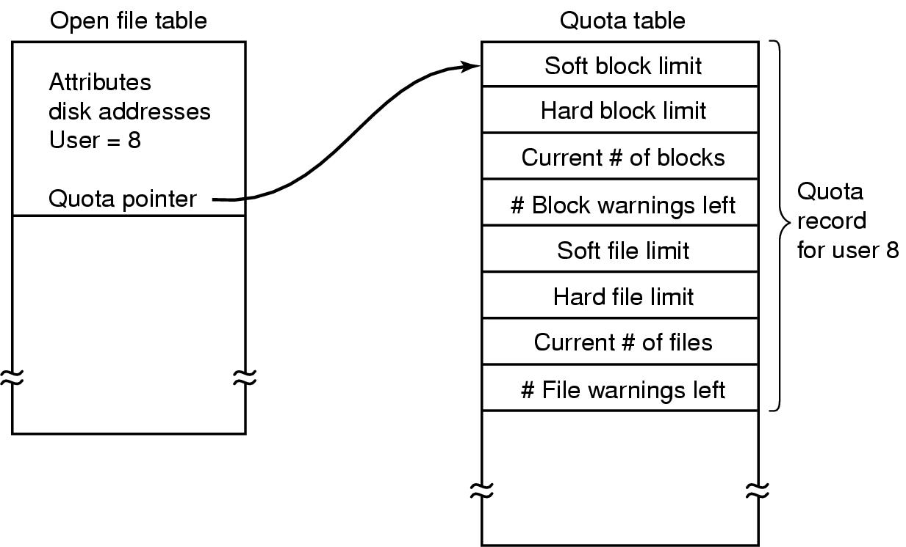
File System Management & Optimization Disk Space Management
Tanenbaum, Fig. 4-24.

Slide 10
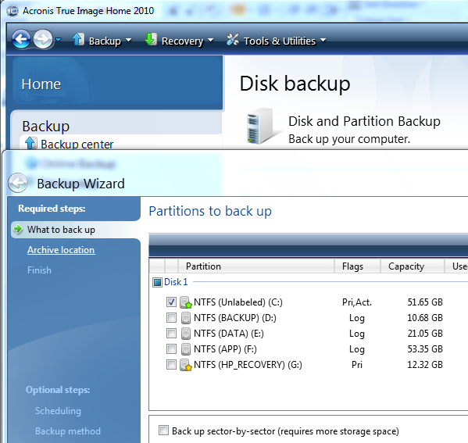
File System Management & Optimization Disk Space Management
File System Backups
Recover data from disaster or from accidentally errors
Making a backup takes a long time and occupies a large mount of space, so doing efficiently and conveniently is important
backup only specific directories
incremental dumps
backup only what was modified from the last backup
can make recovery complicated
compression
Physical dump
Start at block 0 of disk, writes all the disk blocks onto the output tap in order, and stops when it has copied the last one
There is no value in backing up unused disk blocks
Dumping bad block
Advantages: simplicity, great speed
Disadvantages: inability to skip selected directories, make incremental dumps, and restore individual files upon request

Slide 11
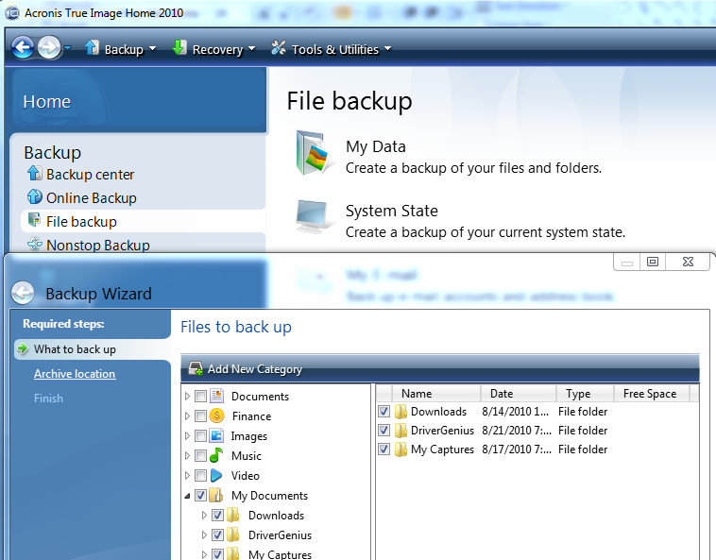
File System Management & Optimization Disk Space Management
File System Backups
Logical dump
Start at one or more specified directories and recursively dumps all files and directories found there that have changed since some given base date
Dumps all directories (even unmodified ones)

Slide 12
File System Management & Optimization Disk Space Management
File System Consistency
Problems
Many file system read blocks, modify them, and write them out later
If the system crashes before all the modified blocks have been written out, the file system can be left in an inconsistent state
If some of the blocks that have not been written out are i-node blocks, directory block, or block containing the free list
Solutions
Using a utility program checks file system consistency in booting or after a crash (ex: scandisk, fsck – fix sick file system)
There are 2 kinds of consistency: blocks and files
To check for block
The program builds two table, each one containing a counter for each block (set 0)
The counter in 1st table keep track of how many time each block is present in a file
The counter in 2nd table record how often each block is present in the free list
The program then reads all the i-nodes using a raw device, which ignores the file structure and just returns all the disk blocks starting at 0
At each block is read, its counter in first table is incremented
The program then examines the free list to find all the block that are not uses
Each occurrence of a block in the free list results in its counter in the 2nd table increased

Slide 13
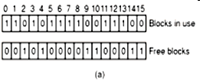

File System Management & Optimization Disk Space Management
Consistency
Tanenbaum, Fig. 4-24.
Missing block: no real harm, waste space and reduce the capacity of disk
Solution: the file system checker adds the missing block to the free list

Slide 14
File System Management & Optimization Disk Space Management
Tanenbaum, Fig. 4-24.
Missing block: no real harm, waste space and reduce the capacity of disk
Solution: the file system checker adds the missing block to the free list

Slide 15

File System Management & Optimization Disk Space Management
Duplicate in free list
Solution: rebuild the free list

Slide 16

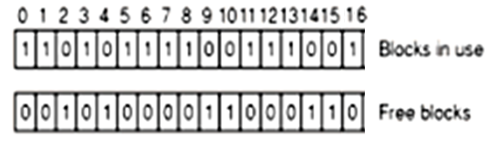
File System Management & Optimization Disk Space Management
Data block is present in two or more files → if the file is removed, both same block is free at the same time and the free is update to 2 as figure c
Solution: allocate the free block and copy one of file blocks to it

Slide 17
File System Management & Optimization Disk Space Management
Directory Consistency
Is used to check for directory and its file in consistency
It uses a table of counters per files
These counts start at 1 when a file is created and are incremented each time a link is made to the file
Traverse the directory tree
A counter is incremented when each every i-node in every directory
When the checker is all done, it has a list, indexed by i-node number, telling how many directories contain each file
It then compares these numbers with the link counts stored in the i-node themselves
Both counts will agree → consistency
The link count is higher: the file are removed, i-node will not be removed (is not serious errors and cause waste space) → fixed by setting the link count in the i-node to the correct value
The link count is lower: 2 directory entries are linked to a file, but the i-node present is only one (disaster and all blocks is release when the file is removed → the one of directories points to an unused i-node) → force the link count in i-node to the actual number of directory entries

Slide 18
File System Management & Optimization Disk Space Management
File System Performance
Access to disk is much slower than access memory because OS must seek to track and then wait for desired sector to arrive under the read head
Many file systems have been designed with various optimizations to improve performance
Cache (Block cache or buffer cache)
Is a collection of blocks that logically belong on the disk but are being kept in memory
Check all read request to see if the needed block is in the cache. If it is, accessing without disk access. Otherwise, reading into the cache, then coping to wherever it is needed
To access quickly, the hash table and the linked list is used
When a block has to be loaded into a full cache, the usual page replacement algorithms is applied (LRU is best)

Slide 19
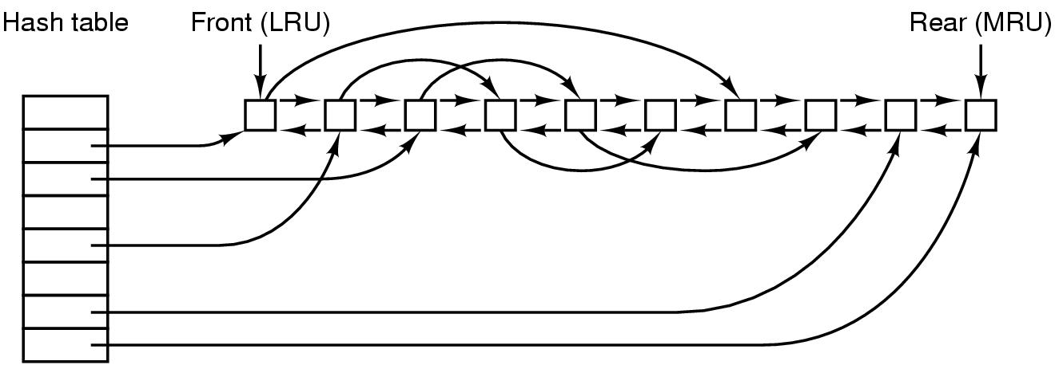
File System Management & Optimization Disk Space Management
File System Performance
Cache (Block cache or buffer cache) (cont)
Problems:
Is the block likely to be needed again soon?
Is the block essential to the consistency of the file system?
Solutions: blocks can be divided into categories such as i-node blocks, indirect block, directory blocks, full data blocks, and partially full data blocks
Blocks that will probably not be needed again soon go on the front, rather than the rear of the LRU list, so their buffers will be reused quickly. Blocks that might be needed again soon, such as a partly full block that is being written, go to the end of the list, so they will stay around for a long time
If the block is essential to the file system consistency, and it has been modified, it should be written to disk immediately (reduce crash)
Tanenbaum, Fig. 4-28.

Slide 20
File System Management & Optimization Disk Space Management
File System Performance
Block Read Ahead
Try to get blocks into the cache before they are needed to increase the hit rate
Many files are read sequentially. When the file system is asked to produce block k in a file, it does that, but when it is finished, it makes a sneaky check in the cache to see if block k + 1 is already there. If it is not, it schedules a read for block k + 1 in the hope that when it is needed, it will have already arrived in the cache
The file system can keep track of the access patterns to each open file. Initially, the file is given the sequential access mode. Whenever a seek is done, the bit is cleared. If sequential reads start happening again, the bit is set once again

Slide 21
File System Management & Optimization Disk Space Management
File System Performance
Block Read Ahead
Try to get blocks into the cache before they are needed to increase the hit rate
Many files are read sequentially. When the file system is asked to produce block k in a file, it does that, but when it is finished, it makes a sneaky check in the cache to see if block k + 1 is already there. If it is not, it schedules a read for block k + 1 in the hope that when it is needed, it will have already arrived in the cache
The file system can keep track of the access patterns to each open file. Initially, the file is given the sequential access mode. Whenever a seek is done, the bit is cleared. If sequential reads start happening again, the bit is set once again

Slide 22
File System Management & Optimization Disk Space Management
File System Performance
Reducing Disk Arm Motion
Put blocks that are likely to be accessed in sequence close to each other, preferably in the same cylinder.
Keep track of disk storage not in blocks, but in groups of consecutive blocks
When allocating blocks, the system attempts to place consecutive blocks in a file in the same cylinder (rotational positioning)
Put the i-nodes in the middle of the disk, rather than at the start, thus reducing the average seek between the i-node and the first block by a factor of two
Divide the disk into cylinder groups, each with its own i-node, blocks, and free list. When creating a new file, any i-node can be chose, but an attempt is made to find a block in the same cylinder group as the i-node. If none is available, then a block in a near by cylinder group is used

Slide 23
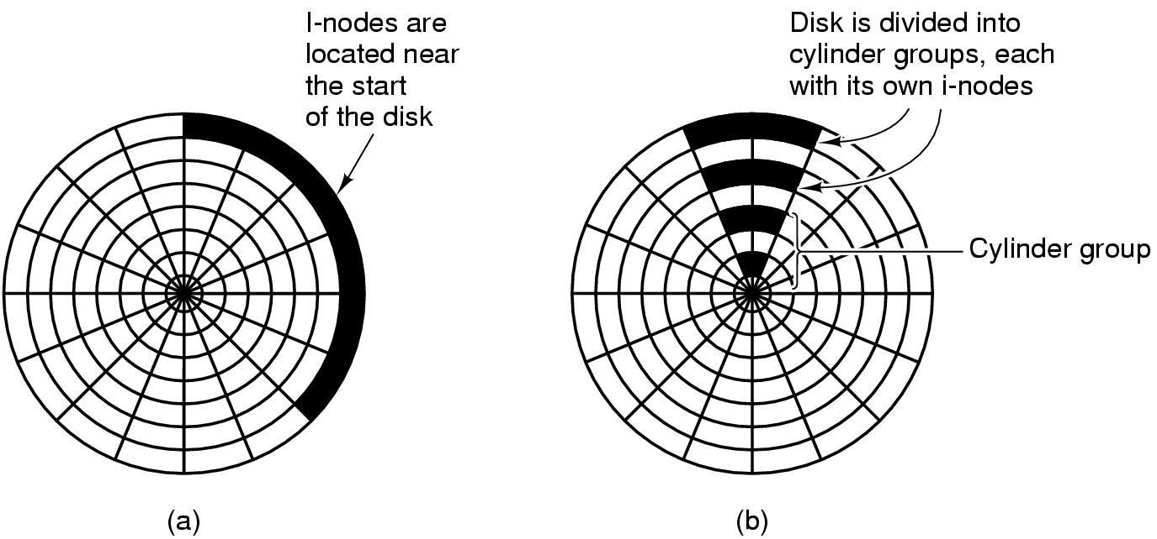
File System Management & Optimization Disk Space Management
Tanenbaum, Fig. 4-29.

Slide 24
File System Management & Optimization Disk Space Management
File System Performance
Defragmenting Disks
Disks become badly fragmented with files and holes all over the place → giving poor performance when new file is created
→ moving files around o make them contiguous and to put all of the free space in one or more large contiguous regions on the disk

Slide 25
Example File Systems CD-ROM File Systems
Simple because they were designed for write once media
They have no provision for keeping tracking of free blocks
Do not have concentric cylinders instead of a single continuous spiral containing the bits in a linear sequence. The bits along the spiral are divided into logical blocks
CD-R
is possible to add files after the initial burning, but these are simply appended to the end of the CD-R
All the free space is in one contiguous chunk at the end of the CD
Files are never removed (although directory can be updated to hide existing files)
ISO 9960
An International Standard in 1998
Make every CD-ROM readable on every computer, independent of the byte ordering used and independent of the OS used

Slide 26
Example File Systems CD-ROM File Systems
Rock Ridge Extensions
In the UNIX community began working on an extension to make it possible to represent UNIX file systems on a CD-ROM
Use the System use field in order to make Rock Ridge CD-ROMs readable on any computer
Any system not aware of the Rock Ridge extensions just ignores them and sees a normal CD-ROM
Rock Ridge extension fields:
PX - POSIX attributes.
PN - Major and minor device numbers.
SL - Symbolic link.
NM - Alternative name.
CL - Child location.
PL - Parent location.
RE - Relocation.
TF - Time stamps.

Slide 27
Example File Systems CD-ROM File Systems
Joliet Extensions
Is invented by Microsoft
Were designed to allow Windows file systems to be copied to CD-ROM and then restored, in precisely the same way that Rock Ridge was designed for UNIX
Joliet extension fields
Long file names.
Unicode character set.
Directory nesting deeper than eight levels.
Directory names with extensions

Slide 28
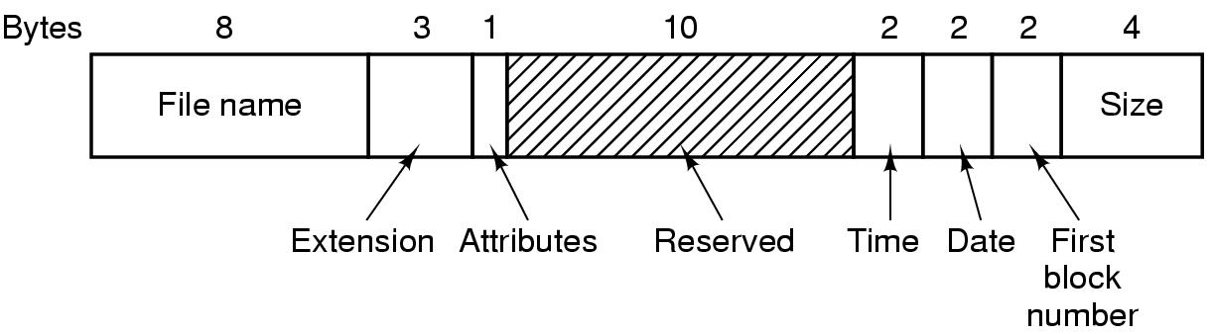
Example File Systems MS-DOS File System
To read a file, MS-DOS must first make an open system call to specifies a path that is looked up component to component until the final directory is located and read into memory. It is then searched for the file to be opened
Use a fixed-size 32 byte directory entry
File names (8 + 3) characters
Stores the file size as a 32 bit number (can be large as 2GB)
Keeps track of file blocks via a FAT in main memory
Tanenbaum, Fig. 4-31.

Slide 29
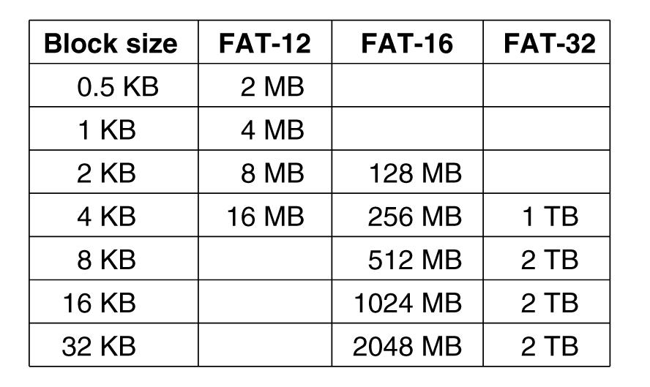
Example File Systems MS-DOS File System
Tanenbaum, Fig. 4-32.

Slide 30
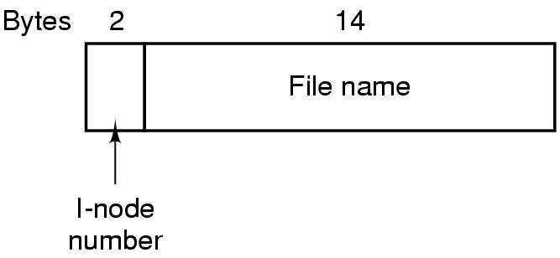
Example File Systems UNIX V7 File System
Form of a tree starting at the root directory, with the addition of links, forming a directed acyclic graph
File names are up to 14 characters and can contain any ASCII character except and NULL
A UNIX directory entry contains one entry for each file in that directory including file name (14 bytes) and the number of i-node (2 bytes).
Each entry is extremely simple because it uses the i-node that can contain some attributes
Tanenbaum, Fig. 4-33.

Slide 31
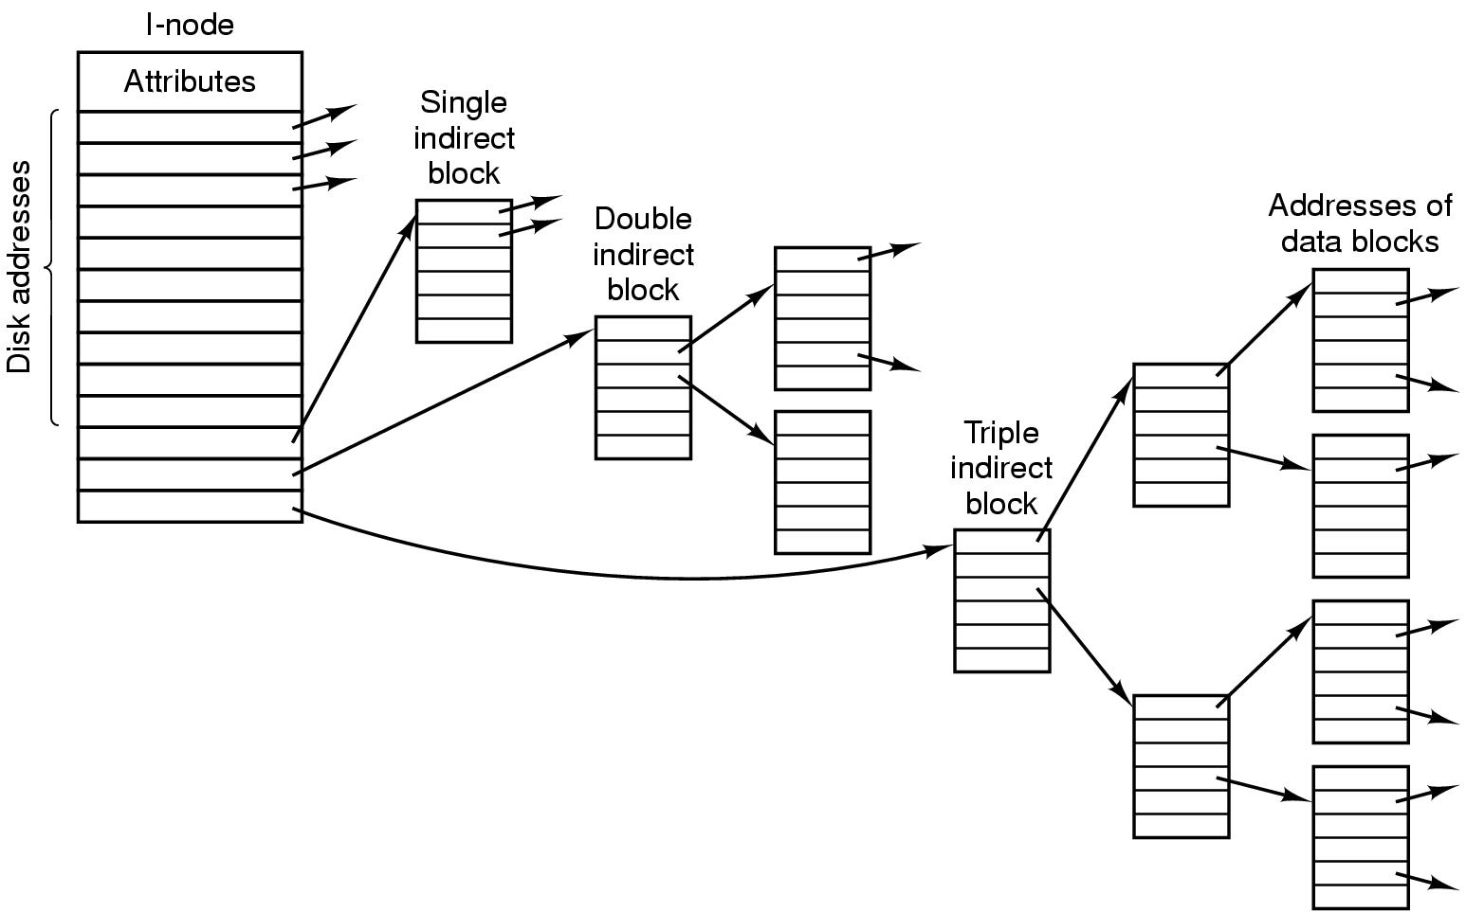
Example File Systems UNIX V7 File System
Tanenbaum, Fig. 4-34.

Slide 32
Summary
Operating System Concepts
Files
Directories
File System Implementation
File System Management and Optimization
Example File Systems
Q&A

Slide 33
Next Lecture
I/O Hardware
I/O Software
Principles
Layers
Disk management
Disk Arm Scheduling Algorithms
Error Handling
Stable Storage

